Slide 1
Simulation
Modeling, Analysis, & Outsourcing
IDS 400, Final Project
Mohammad Abdelmajid, Omar Salka, Harshal Patel, Adam Shibla

Slide 2
Introduction
Maintenance Facility currently providing inspection and repair services to Enterprise Rent-A-Car.
Interested in increasing market share with an additional partnership
* Inspired by 420 simulation class

Slide 3

Our Project Outline
Model the maintenance facility using Python to examine current operational efficiency
Simulate the operations for 1 week, 5 times over
Examine current business model & explore changes for improvement
Provide analysis for a revised business model & improvements

Slide 4
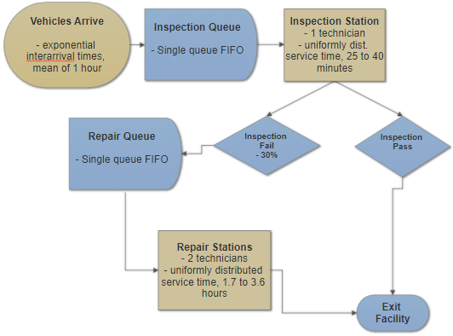
FLOW
CHART

Slide 5
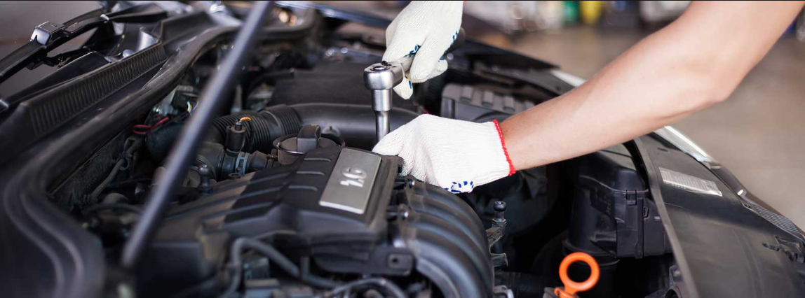
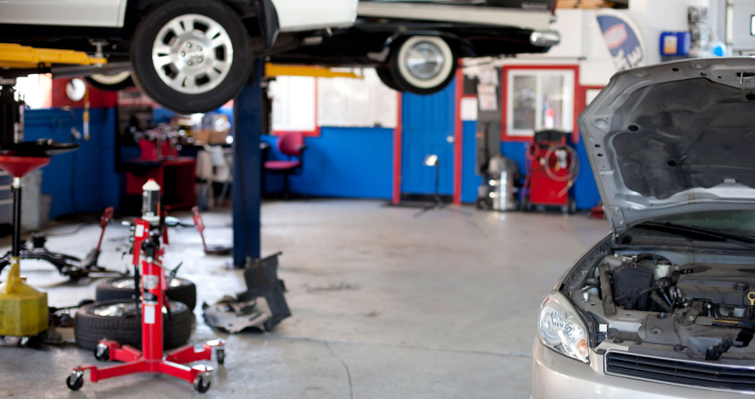
Key Measurements
Average delay of each queue, in hours
Average length of each queue, in vehicles
Utilization of both the inspection stations and repair stations
Service charge revenue
Capacity for throughput of vehicles
Wages wasted on idle workers

Slide 6


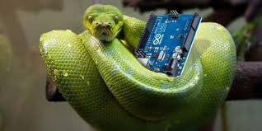
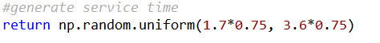
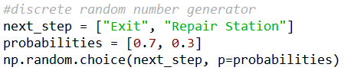
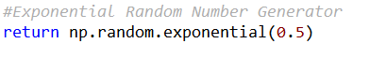
About the code:
Libraries Used:
Pandas
Numpy
Number generators (controlled randomness):

Slide 7
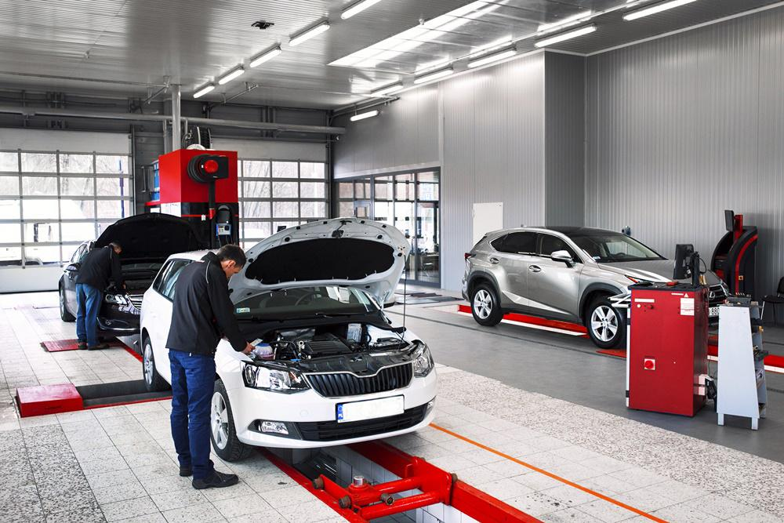
Inspection Station

Slide 8
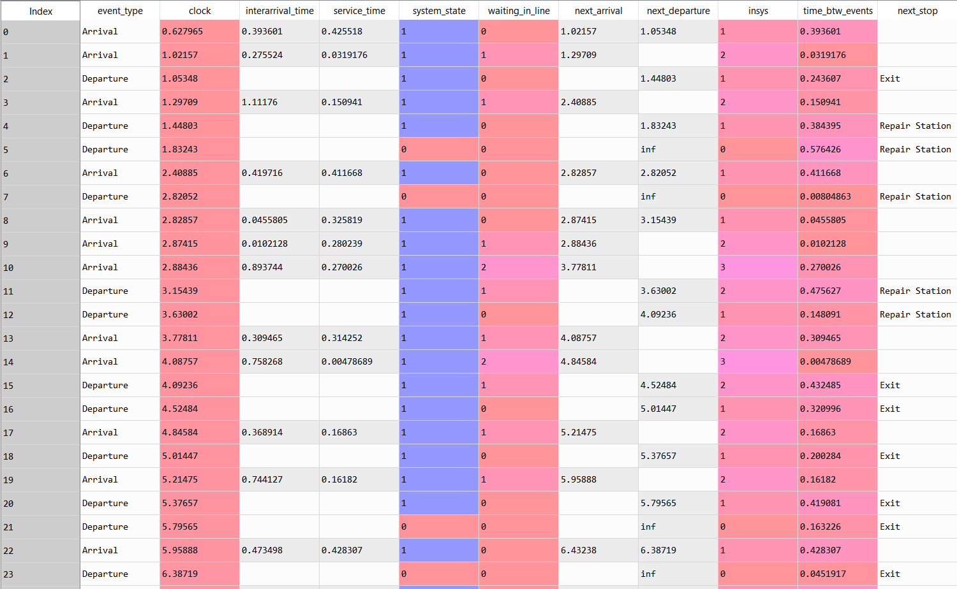
The Data:
Inspection
Station

Slide 9
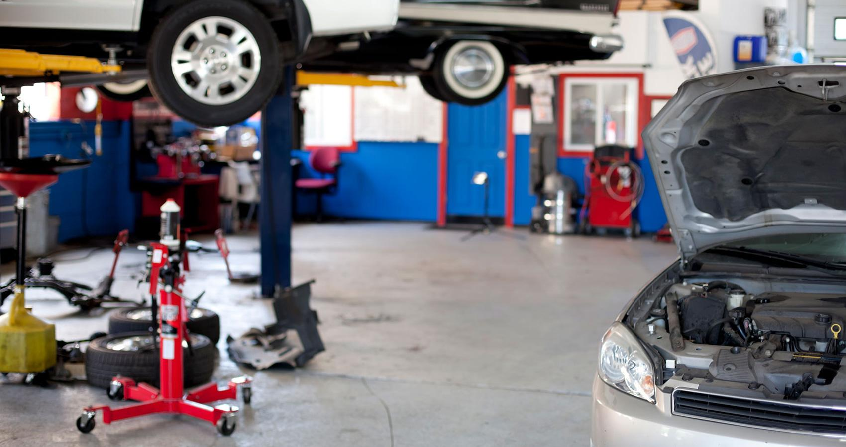
Repair Station

Slide 10
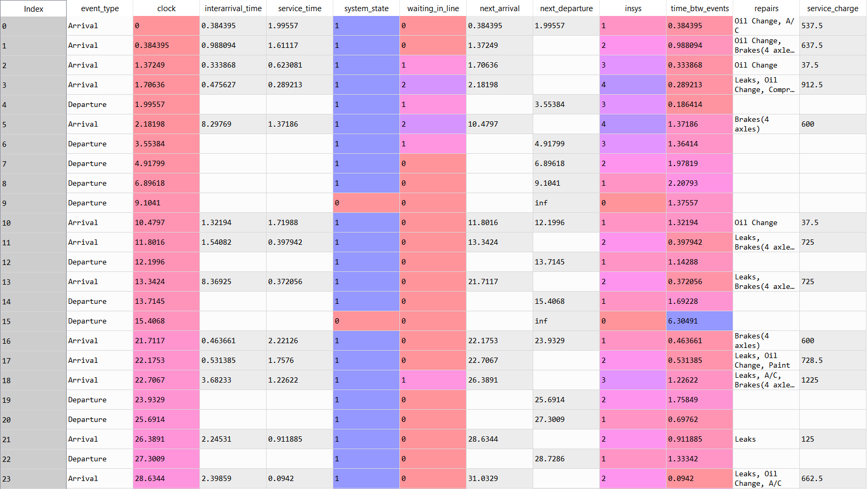
The Data:
Repair
Stations

Slide 11
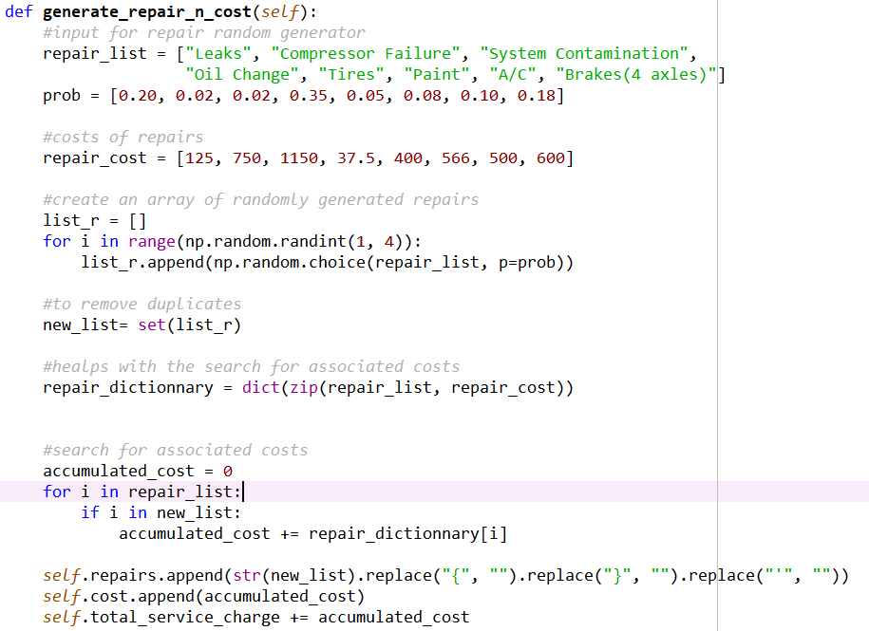
How we assigned repairs and repair costs based on probability

Slide 12
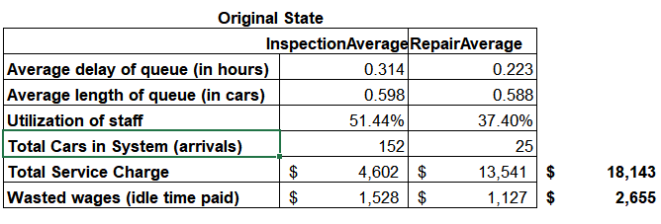
Results - Current State:

Slide 13


Slide 14

Adding Partnership
Currently servicing Enterprise cars
Propose to Avis that we will maintain their cars
Increase capacity for additional incoming vehicles
Original time is 1 hour

Slide 15
Exploring new opportunities
We need to invest in new equipment to meet Avis’ volume needs
We were underutilized at the moment
Need to improve both our inspection and repair service time
Adding more partnerships means our mean inter-arrival will decrease in half (to 30 mins)

Slide 16
Business Decisions
Meet the 80%utilization rate for our company standards
Decrease both inspection and repair service time by 25% by upgrading equipment

Slide 17
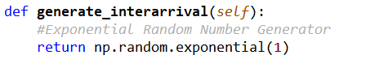
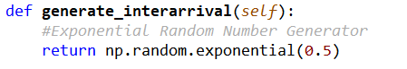
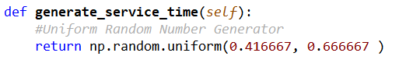
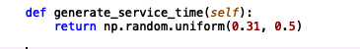
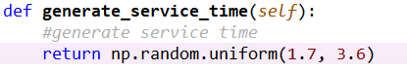
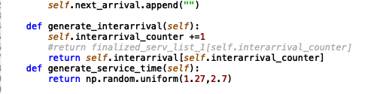
Code Change
Current State
Changed State

Slide 18
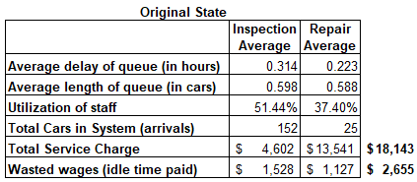
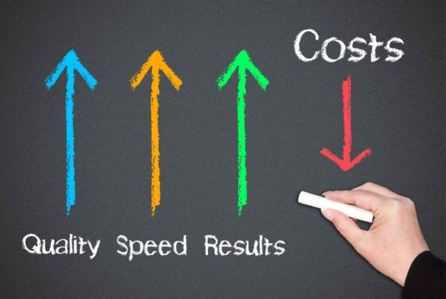
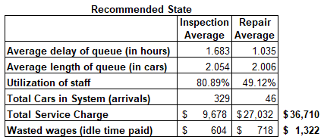
Improvement Analysis
Notes:
(80.89+49.12)/(51.44+37.4)

Slide 19
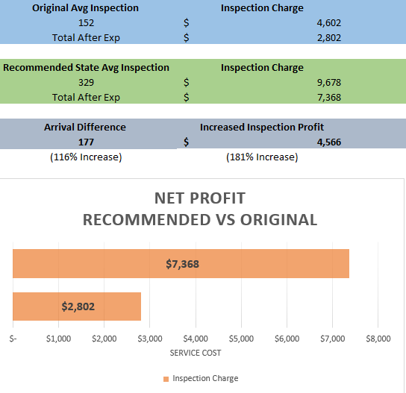
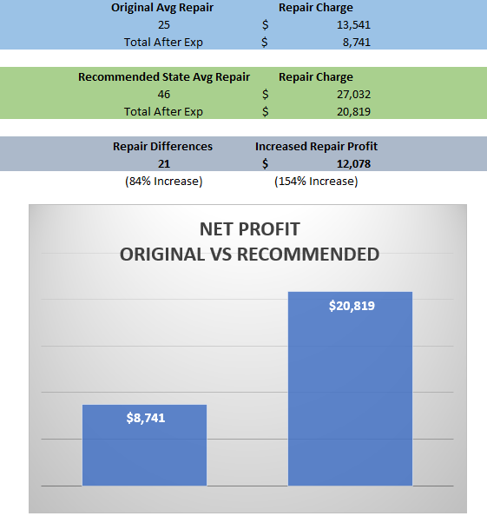
Financial Analysis

Slide 20
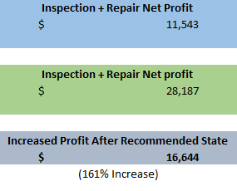
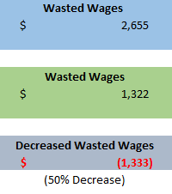
Financial Analysis

Slide 21

THANKS!
Any questions?

